Slide 1

Under Fire:
Reporting From the Frontlines of the Trump White House
Author: April Ryan
Presentation by: Jade Boone

Slide 2

Table of Contents
01
About the author
04
What I learned
02
Quote
05
Themes/Key Points
03
Synopsis
06
Conclusions
April Ryan
What the book entails
End of Story

Slide 3

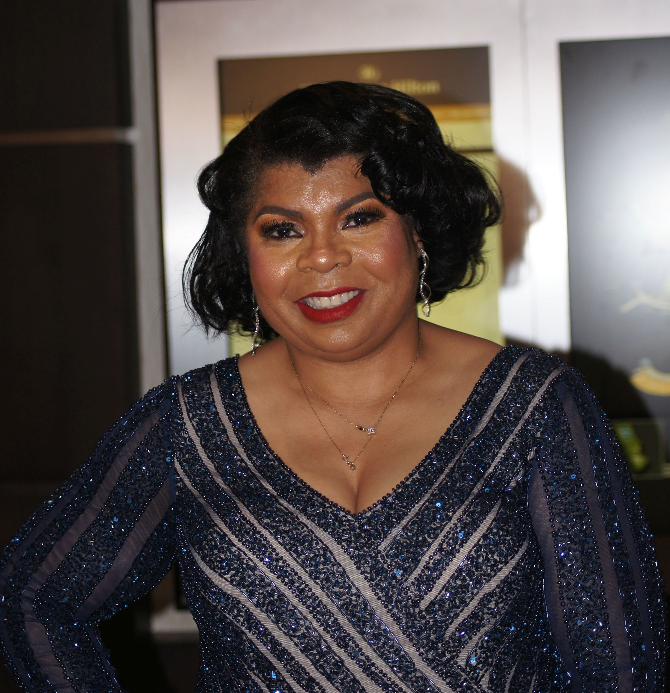
April Ryan
April Danielle Ryan is an American Correspondent and author. Since 1997, she has served as a White House correspondent and is the Washington, D.C., bureau chief for American Urban Radio Networks. In 2017, she joined CNN as a political analyst. She has been featured in Vogue, Cosmopolitan, The New York Times, Washington Post, and Elle Magazine. She has also appeared on numerous television news programs. She is the 2017 National Association of Black Journalists, Journalist of the Year.

Slide 4

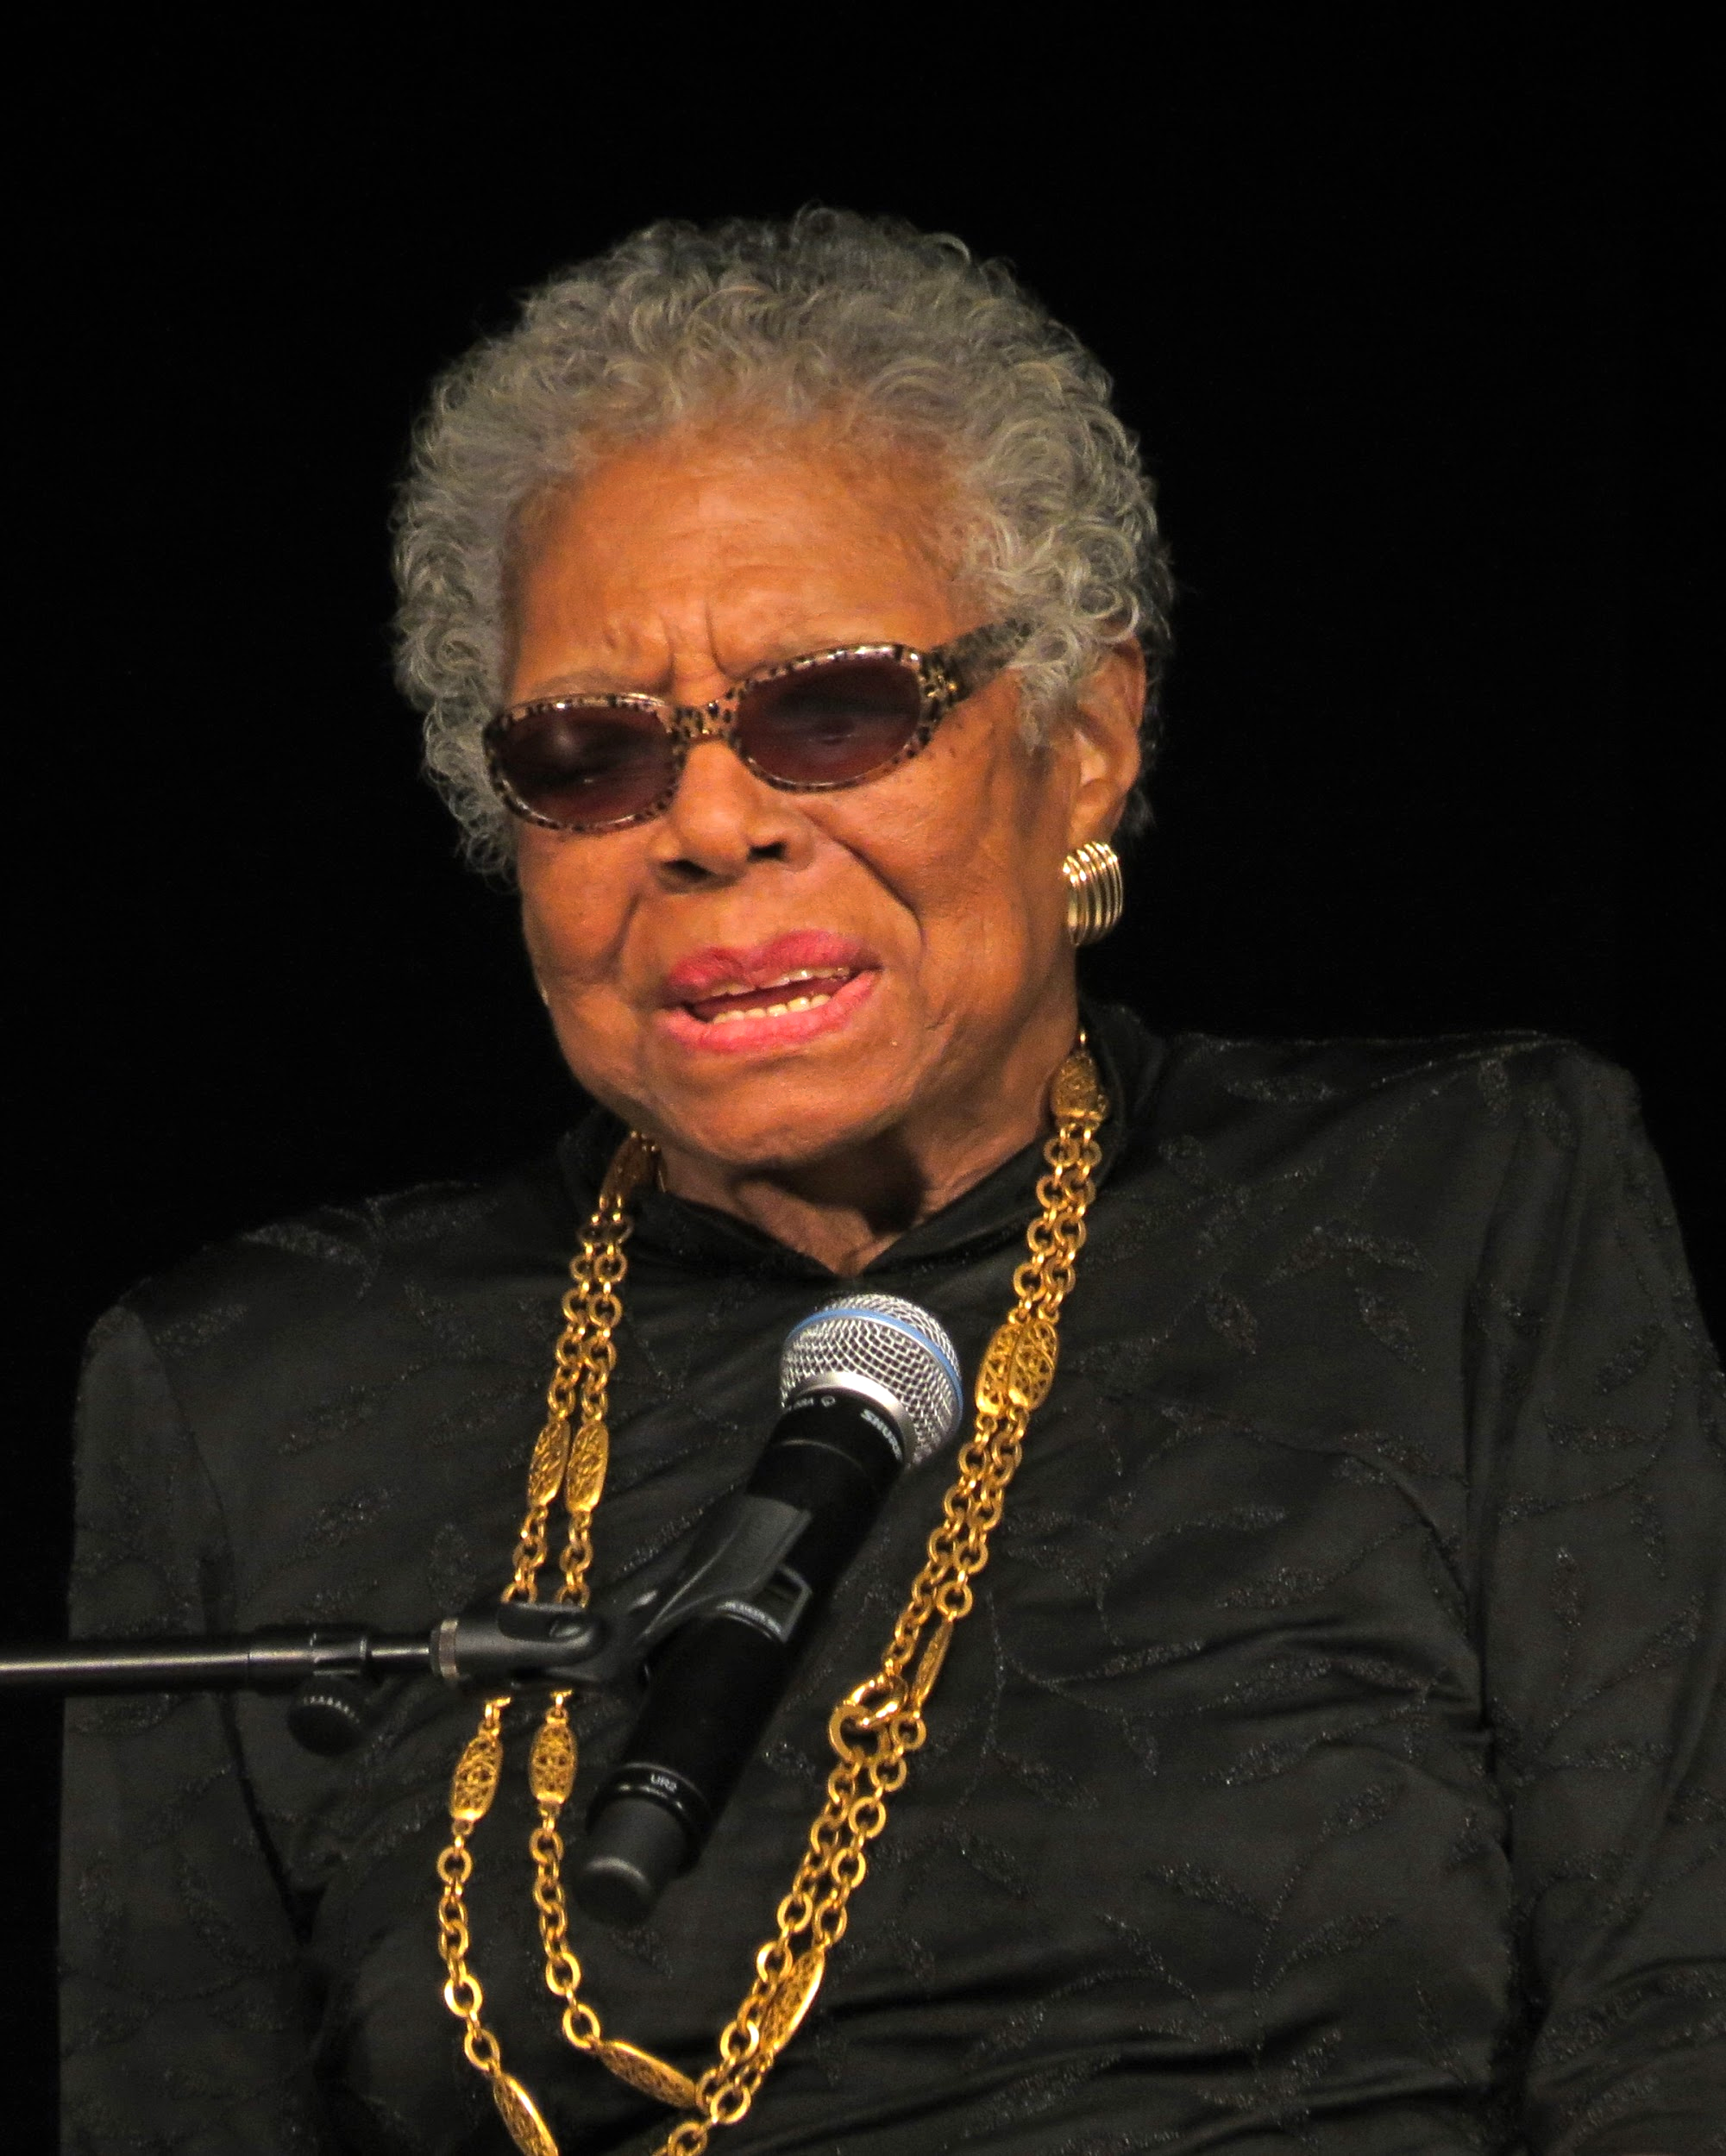
“If you don't like something, change it. If you can't change it, change your attitude"
- Maya Angelou

Slide 5
Synopsis
April Ryan takes us behind the scenes of what it’s like to be a journalist in a Trump White House. She details the influence of asking the hard questions no one else will. In Under Fire, Ryan takes us inside the confusion and chaos of the Trump White House to understand how she and other reporters adjusted to the new normal. She takes us inside the policy debates, the revolving door of personnel appointments, and what it is like when she, as a reporter asking difficult questions, finds herself in the spotlight, becoming part of the story. With the world on edge and a country grappling with a new controversy almost daily, Ryan gives readers a glimpse into current events from her perspective, not only from inside the briefing room but also as a target of those who want to avoid answering probing questions.

Slide 6

What I learned
An interview Trump did saying he thought being President would be “easier”
Trump has a way of lying and twisting words to his agenda
Black journalists in the White House did not usually have access to interview/question republican candidates
Start time for Trump is 11:30am, first president April Ryan experienced w/ later schedule
Republicans changed the name of the Affordable Care Act to remove the law and Obama’s name from it
Trump administration treated April Ryan with premeditated aggression
As a journalists you have to remain composed even under attack from employers but also stand up for yourself.
Don’t give up

Slide 7

Themes
What I gathered from the book:
Courage and Perseverance
Appearance vs Reality
Coming of age
Knowledge vs Ignorance

Slide 8

Conclusion
Thank you for being engaged

Slide 9
References
April Ryan (2018). Under Fire, Rowman & Littlefield Publishers

Slide 10

Resources
http://www.stlamerican.com/news/editorials/trump-attacks-black-women-because-he-fears-us/article_1178295c-e882-11e8-8d17-c7a4cbe29bd1.html
https://www.baltimoresun.com/opinion/columnists/zurawik/bs-fe-zontv-sanders-ryan-lies-slander-20190419-story.html

